Slide 1
Inventories - Accounting Principles
2022. 5.
Yangin Yoon

Slide 2
Recap the previous class
First-in, first out (FIFO)
- First purchase amount is the first cost assigned to cost of goods sold
- Ending inventory is based on the latest purchase amounts
Last-in, first-out (LIFO)
- Costing is the opposite of FIFO
- Last purchase amount goes immediately to cost of goods sold
- Ending inventory is based on the oldest purchase amount
Weighted-Average Cost
- Based on the average unit amount of inventory during the period

Slide 3

Recap the previous class
The ABC OIL started its business on 20X2. 1.10.
This is a gasoline station, and it sells only one type of gasoline.
It has bought gasoline from its suppliers. The company use FIFO methods.
20X2. 2. 1. the shop sold 350 liters. How much is the cost of goods?
100 * 20
+ 250 * 15 = 2000 + 3750 = 5,750
20X2. 3. 26. the shop sold 600 liters. How much is the cost of goods?
50 * 15
+ 500*18
+ 50 *16 = 750 + 9000 + 800 = 10050
Date | Amounts (liters) | Unit price ($/liter) | Total Value
20X2. 1. 15. | 100 | 20 | 2,000
20X2. 1. 25. | 300 | 15 | 4,500
20X2. 2. 20. | 500 | 18 | 9,000
20X2. 3. 25. | 400 | 16 | 6,400

Slide 4

Recap the previous class
The ABC OIL started its business on 20X2. 1.10.
This is a gasoline station, and it sells only one type of gasoline.
It has bought gasoline from its suppliers. The company use FIFO methods.
20X2. 2. 1. the shop sold 350 liters. How much is the cost of goods?
20X2. 3. 26. the shop sold 600 liters. How much is the cost of goods?
Date | Amounts (liters) | Unit price ($/liter) | Total Value
20X2. 1. 15. | 100 | 20 | 2,000
20X2. 1. 25. | 300 | 15 | 4,500
20X2. 2. 20. | 500 | 18 | 9,000
20X2. 3. 25. | 400 | 16 | 6,400
Cash XXX
Revenue XXXX
Cost of goods 5,750
Inventory 5,750
Cash XXX
Revenue XXXX
Cost of goods 10,050
Inventory 10,050

Slide 5
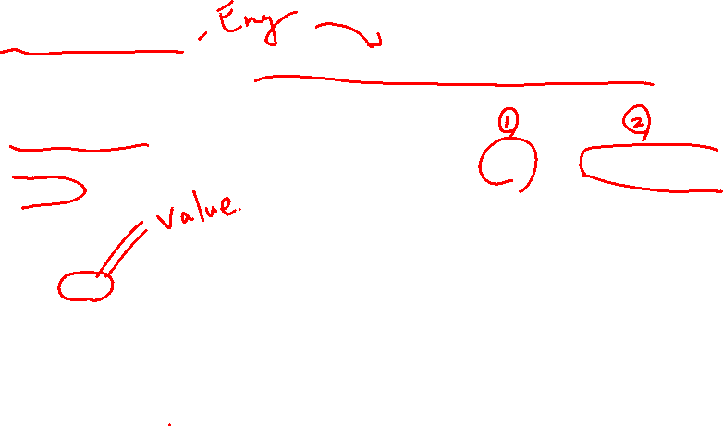
Measurement of Inventories
IFRS Standard
- IAS 2 Inventories
- This is equivalent to “기업회계기준서(K-IFRS) 제1002호 재고자산.”
Paragraph 9
- Inventories shall be measured at the lower of cost and net realisable value.
Paragraph 10
- The cost of inventories shall comprise all costs of purchase, costs of conversion and other costs incurred in bringing the inventories to their present location and condition.
http://www.kasb.or.kr/fe/accstd/NR_list.do?sortCd=K-IFRS

Slide 6
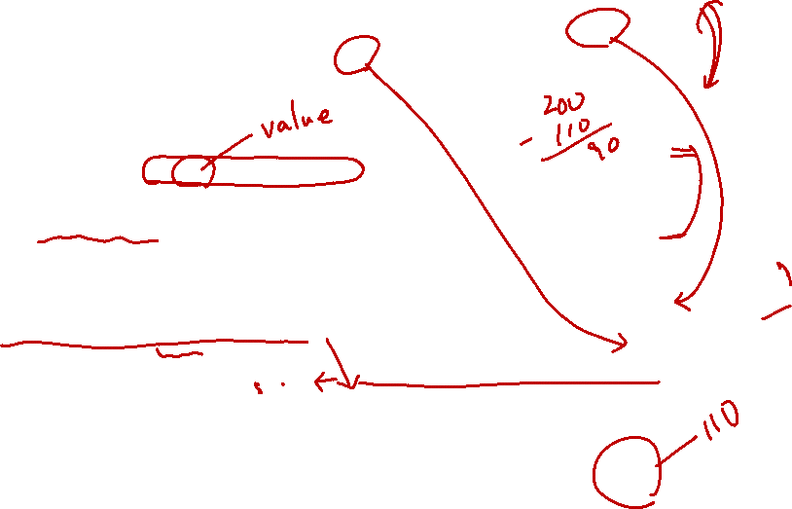
Measurement of Inventories
ABC OIL bought gasoline from its supplier. ABC OIL paid $100 to its supplier. In addition, ABC OIL paid $10 to a delivery company for oil transportation. All transactions occurred with cash.
- Provide the journal entry.
Paragraph 10 – “The cost of inventories shall comprise all costs of purchase, costs of conversion and other costs incurred in bringing the inventories to their present location and condition.”
Journal Entry
Inventory $100
Cash $100
Transportation expense $10
Cash $10
Inventory $10
Transportation expense $10
→
Inventory $110
Cash $100
Cash $10

Slide 7
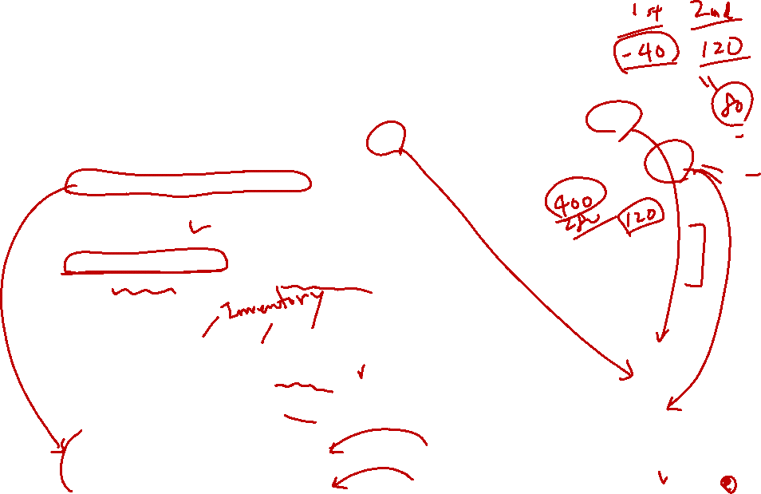
Measurement of Inventories
ST Toy bought raw material from its supplier. ST Toy paid $200 to its supplier. In addition, ST Toy paid $80 to the factory workers as wage. The accounting department employees of ST Toy were also paid $40. ST Toy manufactured toys and used up all of its raw material. All transactions occurred with cash.
Paragraph 10 – “The cost of inventories shall comprise all costs of purchase, costs of conversion and other costs incurred in bringing the inventories to their present location and condition.”
Journal Entry
Raw material (asset) $200
Cash $200
Factory worker salary expense $80
Cash $80
Acct worker salary expense $40
Cash $40
Product (asset, inventory) $200
Raw material (asset) $200
Product (asset , inventory) $80
Factory worker salary expense $80

Slide 8
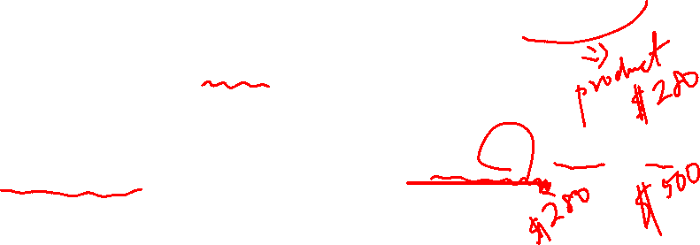
Measurement of Inventories
ST Toy bought raw material from its supplier. ST Toy paid $200 to its supplier. In addition, ST Toy paid $80 to the factory workers as wage. The accounting department employees of ST Toy were also paid $40. ST Toy manufactured toys and used up all of its raw material. All transactions occurred with cash.
The toys can be sold $500 in the market.
- Provide the general entry.
Paragraph 9 – “Inventories shall be measured at the lower of cost and net realisable value.”
Journal Entry
→ No additional journal entry is needed.

Slide 9
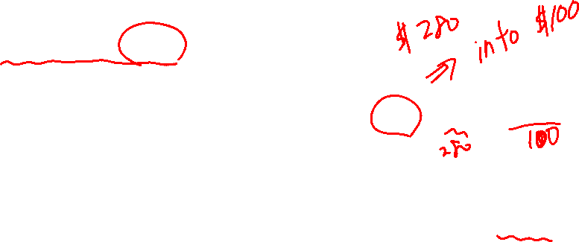
Measurement of Inventories
ST Toy bought raw material from its supplier. ST Toy paid $200 to its supplier. In addition, ST Toy paid $80 to the factory workers as wage. The accounting department employees of ST Toy were also paid $40. ST Toy manufactured toys and used up all of its raw material. All transactions occurred with cash.
The toys can be sold $100 in the market.
- Provide the general entry.
Paragraph 10 – “Inventories shall be measured at the lower of cost and net realisable value.”
Journal Entry
Inventory write-down (expense) $180
Product (asset) $180

Slide 10
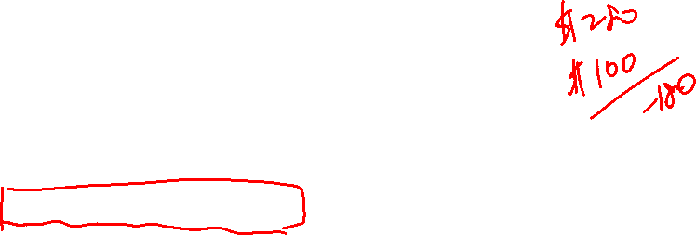
Measurement of Inventories
ST Toy bought raw material from its supplier. ST Toy paid $200 to its supplier. In addition, ST Toy paid $80 to the factory workers as wage. The accounting department employees of ST Toy were also paid $40. ST Toy manufactured toys and used up all of its raw material. All transactions occurred with cash.
The toys can be sold $100 in the market.
- Provide the general entry.
Paragraph 10 – “Inventories shall be measured at the lower of cost and net realisable value.”
(K-GAAP 7 – Paragraph 7.20)
Journal Entry
Inventory write-down (expense) $180
Accumulated loss (asset) $180
http://www.kasb.or.kr/fe/accstd/NR_list.do?sortCd=G-COMPANY
https://dart.fss.or.kr/dsaf001/main.do?rcpNo=20220323000843

Slide 11
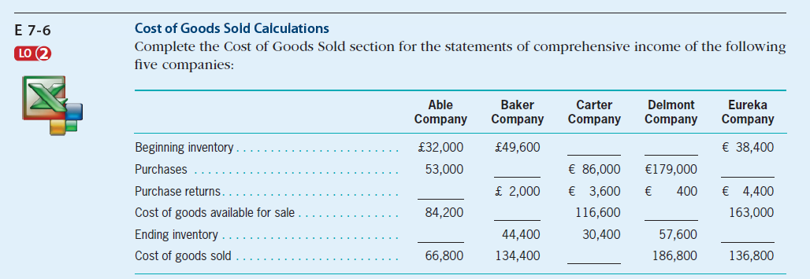
Inventories (exercise)
Self-Study Material (in the e-class, Chapter #7)
© 2017 Cengage Learning, Principles of Financial Accounting, 2/E (IFRS Edition)

Slide 12
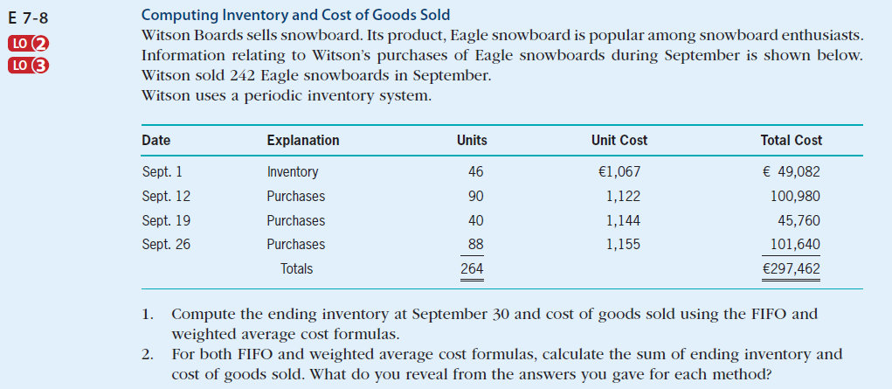
Inventories (exercise)
Self-Study Material (in the e-class, Chapter #7)
© 2017 Cengage Learning, Principles of Financial Accounting, 2/E (IFRS Edition)

Slide 13
Any Questions?

Slide 14
Receivable and Payable - Accounting Principles
2022. 5.
Yangin Yoon
© 2017 Cengage Learning, Principles of Financial Accounting, 2/E (IFRS Edition)

Slide 15
Receivable
Receivable
- One type of assets
- Claims for money, goods, or services
Accounts Receivable
- A current asset representing money due for services performed or merchandise sold on credit.
Notes Receivable
- A contract in the form of a note received by a company and written by its customer as a result of the company’s selling goods or providing services to the customer on credit.

Slide 16
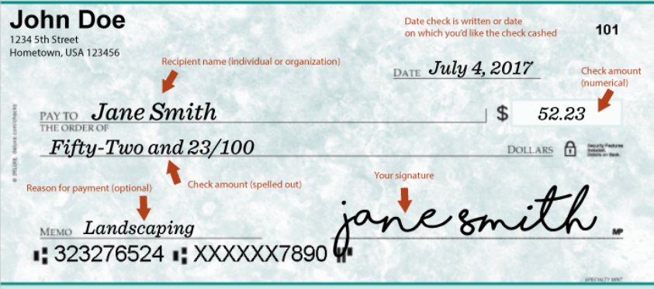
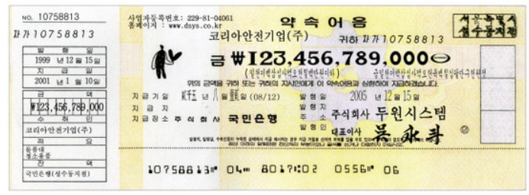
Receivable
Notes or Checks
https://www.nwcu.com/learn/how-to-use-checks
https://m.blog.naver.com/kgattaca/220427008499

Slide 17
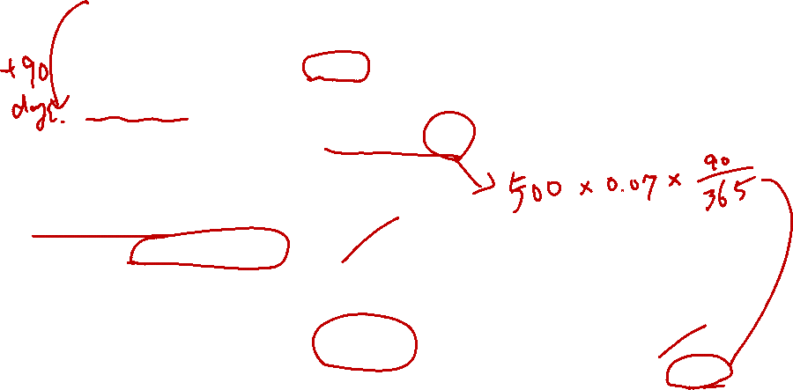
Receivable
Example
- 2022.4.30.
ABC Company sold goods to XYZ Company for $500. ABC Company accepted a 90-day, 7% note for this transaction from XYZ Company.
- 2022.7.29.
ABC Company received cash of $508.63 for the exchange of the note that it received in April.
Journal Entry
2022.4.30.
Note receivable $500
Cost of Goods XXX
Revenue $500
Inventory XXX
2022.7.29.
Cash $508.63
Note receivable $500.00
Interest Income $8.63
* “Interest Income” is a revenue type account.

Slide 18
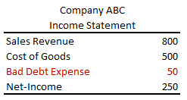
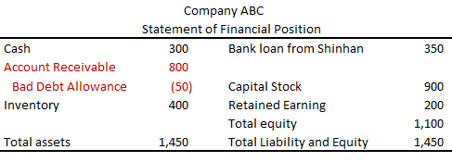
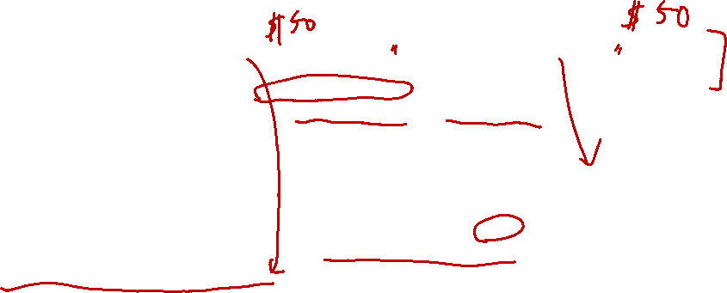
Evaluation of Receivable
We evaluate the value of receivable periodically.
- If a customer is broken, or in trouble, we may not receive the promised amount of money from the customer. If so, we need to include this information in the financial statements.
Bad Debt Expense XXX
Allowance for Bad Debts XXX
* “Bad Debt Expense” is an expense type account.
“Allowance for Bad Debts” is an asset type account (A contra account to Accounts Receivable).

Slide 19
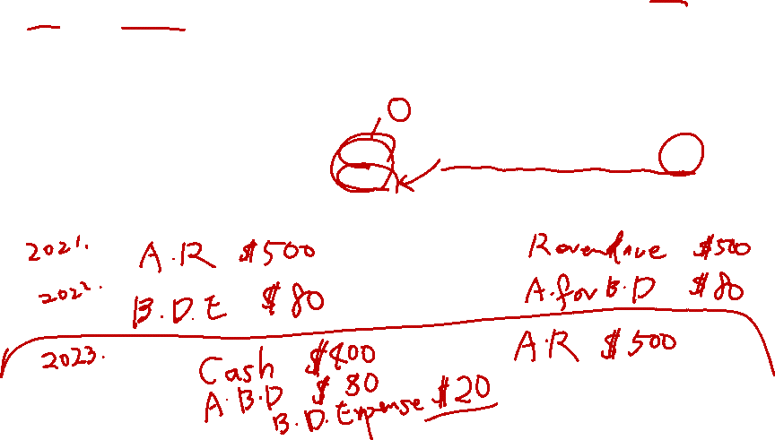
Settlement of Receivable
Finally, it is settled that the account receivable is paid by cash (all, some, or nothing).
- If the final decision is made, we remove (derecognize) the relevant accounts from our accounting book.
Cash XXX
Allowance for Bad Debts ZZZ
Bad Debt Expense YYY – XXX - ZZZ
Accounts Receivable YYY

Slide 20
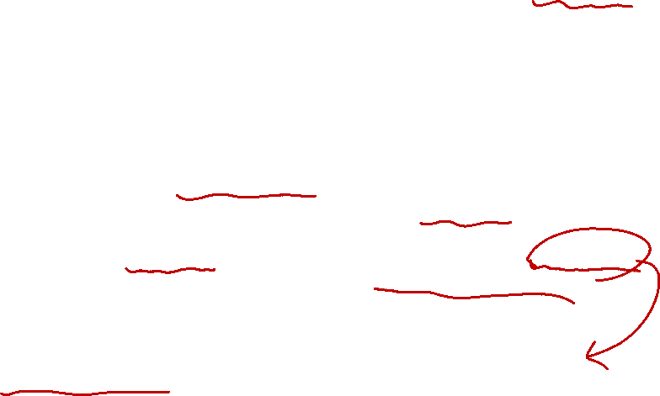
Evaluation of Receivable (Aging)
Estimating the value of accounts receivable
Aging is one of the way to estimate the uncollectible amounts (and collectible amounts).
- Each receivable is categorized by the number of days it has been outstanding (or the number of days from its due date).
- Each total is multiplied by an appropriate uncollectible percentage. This is based on the assumption that the older the receivable, the less likely the company is to collect.
- Usually, the uncollectible percentage is decided based on the historical records.

Slide 21
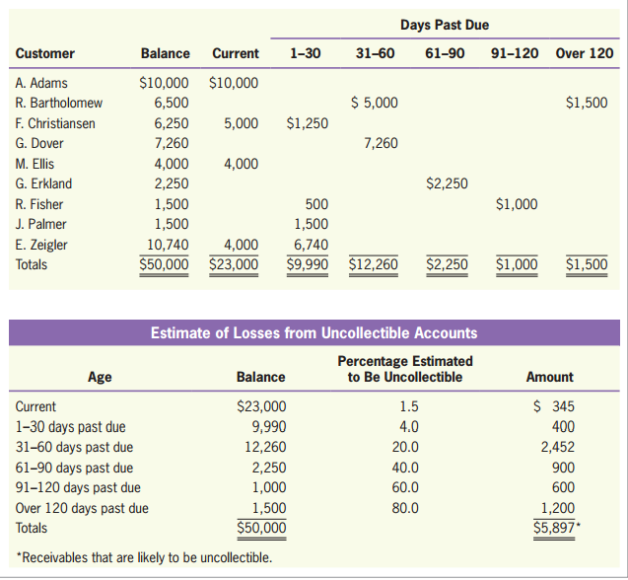
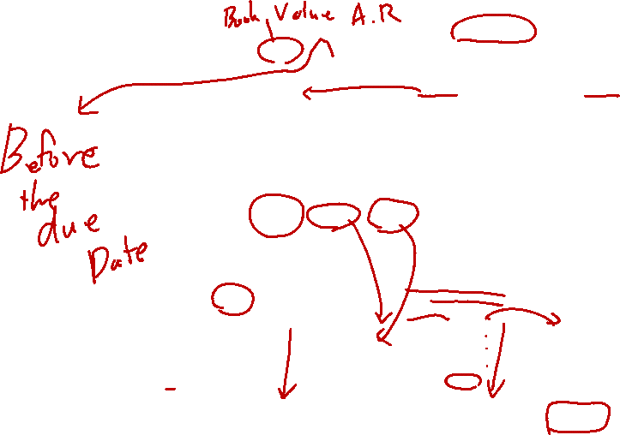
Evaluation of Receivable (Aging)
Example
© 2017 Cengage Learning, Principles of Financial Accounting, 2/E (IFRS Edition)

Slide 22
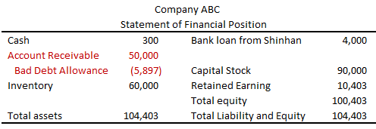
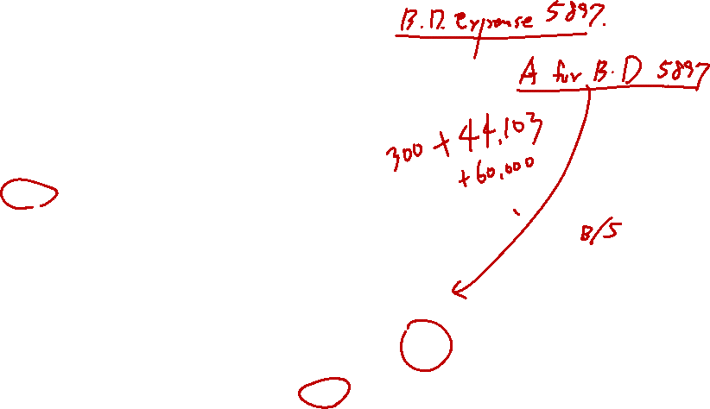
Evaluation of Receivable (Aging)
Example
© 2017 Cengage Learning, Principles of Financial Accounting, 2/E (IFRS Edition)

Slide 23

Payable and Other Liability
Payable
- One type of liability
- Obligation for money, goods, or services.
Accounts Payable
- A current liability representing money due for services received or merchandise purchased on credit.
Advances from customers (or unearned revenue)
- A money received but we have not provided merchandise or service to our customer
- We will provide the merchandise or service in the future.

Slide 24

Bakery Case #3 (Week #1 Slides)
AP Bakery Inc. started its business on 1st of November.
- All transactions were made by cash.
 | Nov. 1st~Nov.30th | Dec. 1st ~ Dec. 31st | Jan. 1st ~ Jan. 31st
Shop rent (deposit) | 1,500,000 | - | -
Shop monthly rent fee | 500,000 | 500,000 | 500,000
Oven, tables, and chairs purchase | 8,000,000 | - | -
Flour, sugar, and egg purchase | 3,000,000 | 3,000,000 | 3,000,000
Number of baked muffins | 10,000 | 10,000 | 10,000
Value of baked muffins | 10,000,000 | 10,000,000 | 10,000,000
Number of sold muffins | 8,000 | 9,000 | 9,500
Value of sold muffins | 8,000,000 | 9,000,000 | 9,500,000
Electricity charge (paid on the 20th of every month) | 200,000 | 600,000 | 900,000
Donation of muffins | - | - | -
Salary for Tom and Sam | 2,000,000 | 2,000,000 | 2,000,000
Dividend to the shareholders |  | 3,000,000
Number of muffin gifticons issued |  |  | 10,000
Received cash for the gifticon issuance |  |  | 9,000,000

Slide 25
Bakery Case #3 (Week #1 Slides)
In this case, AP Bakery issued gifiticons, instead of borrowing money from a bank on Jan. 31st.
1) On Feb. 1st, your cousin, Chris, said that he wanted to buy the whole AP Bakery Inc. What would be the appropriate amount for this deal?
2) The gifticons were non-refundable. What would be your answer to Question#1?
3) The gifticons were fully refundable. What would be your answer to Question#1?
4) Is the amount different from Bakery Case #2?
5) AP Bakery Inc. paid its electricity bill on Jan 20th. The bill covered the period between Dec 15th and Jan 15th. The electricity charge between Jan. 15th and Jan. 31st would be 500,000 KRW.
Does this additional information change the amounts that Chris may offer?

Slide 26
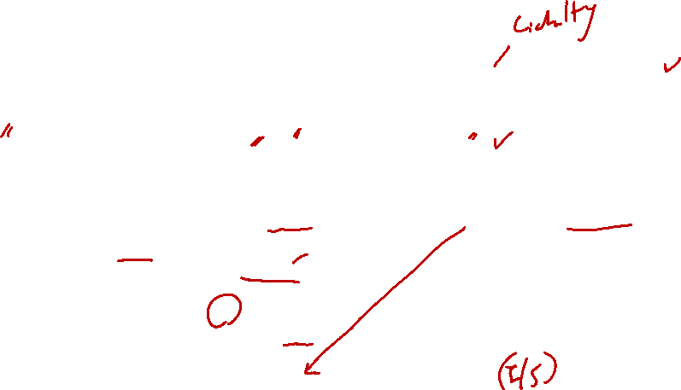
Payable and Other Liability
Accounts Payable
- A company bought goods of $400 on credit.
Advances from customers (or unearned revenue)
- A company issued 100 gifticons. It received $500 of cash from customers.
- A customer presented a gifticon. The company gave the customer the goods whose book value was $4.
Inventory $400
Accounts Payable $400
Cash $500
Advanced from customers $500
* “Cash” is an asset type account.
“Advanced from customers” is a liability type account (“Unearned revenue” is also liability.)
Advanced from customers $5
Cost of goods $4
Revenue $5
Inventory $4

Slide 27

Any Questions?

Slide 28
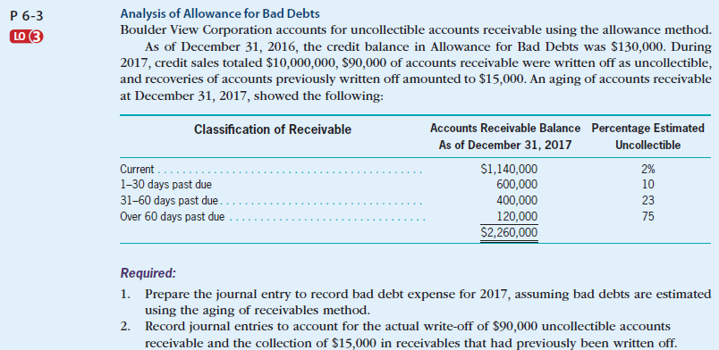
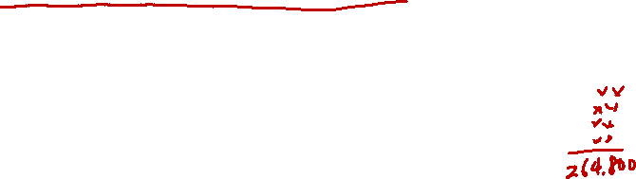
Receivable and Payable(exercise)
Self-Study Material (in the e-class, Chapter #6)
© 2017 Cengage Learning, Principles of Financial Accounting, 2/E (IFRS Edition)

Slide 29
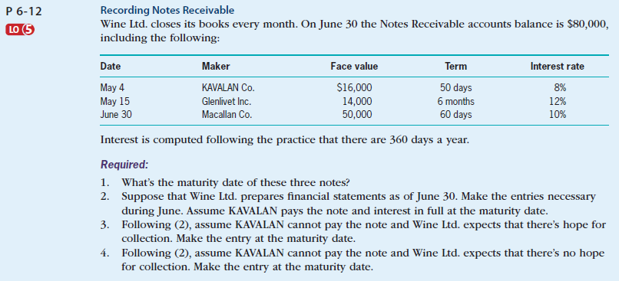
Receivable and Payable(exercise)
Self-Study Material (in the e-class, Chapter #6)
© 2017 Cengage Learning, Principles of Financial Accounting, 2/E (IFRS Edition)

Slide 30
Any Questions?

Slide 31
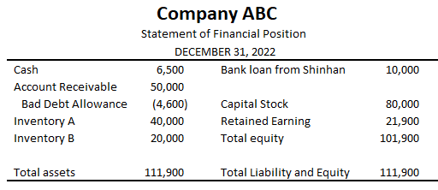
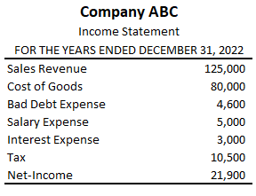
Audit (Financial Statement Audit)
You and your friends made Company ABC with $80,000 of cash. You hired CEO, CFO, and other workers for the company. After one year, the CEO presented you the following financial statements.
If you want to check a few things about the financial statements. What will you check?

Slide 32
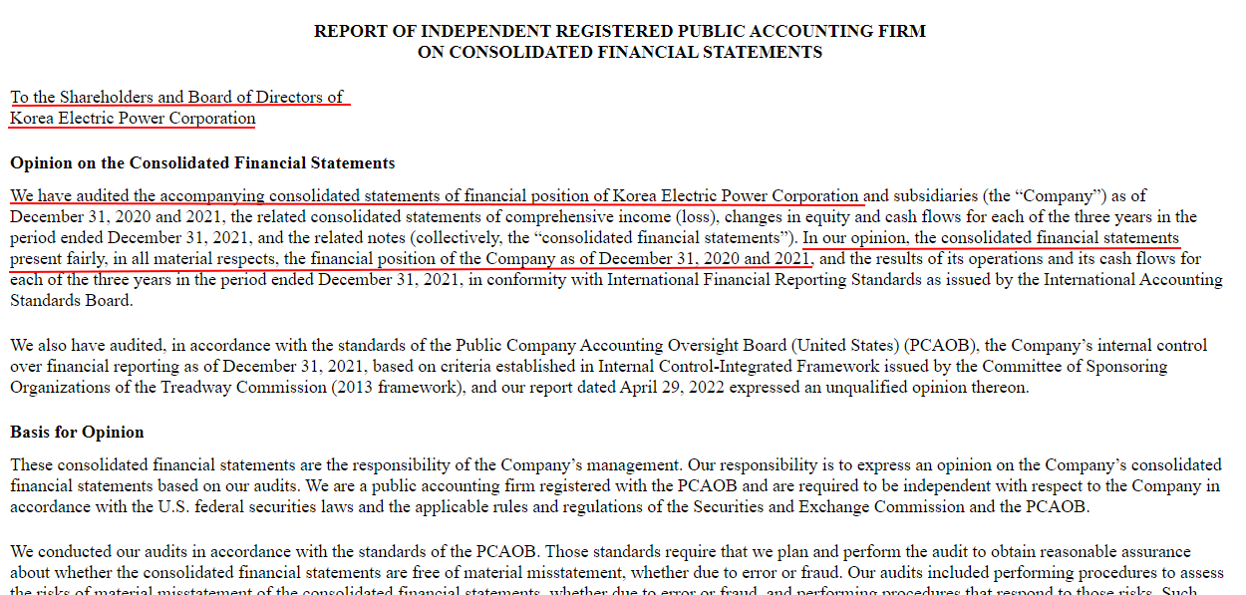
Audit (Financial Statement Audit)
The trusted third party (auditor) checks the financial statements.
- Accounting information users can make a decision based on the audited financial statements.
https://www.sec.gov/Archives/edgar/data/887225/000119312522132015/d276732d20f.htm#fin276732_1
https://dart.fss.or.kr/dsaf001/main.do?rcpNo=20220321001499&dcmNo=8487719

Slide 33
Any Questions?

